Slide 1
Research Questions
How does seasonality influence the occurrence of algal blooms within Loch Leven?
What are the drivers (chemical and physical) of algal blooms in Loch Leven?
How does environmental drivers influence the composition of phytoplankton communities within Loch Leven?

Slide 2
Variables | Ranking for lmer | References | Notes
SRP | 1 | 10.1007/s10750-011-0923-x 10.1111/j.1365-2427.2007.01865.x 10.1080/20442041.2020.1827891 10.1007/s10750-013-1525-6 10.1016/j.ecolind.2022.109560 10.1016/j.hal.2019.02.002 | Nutrient availability (10.1016/j.envpol.2020.116210)
SD | 9 | 10.1007/s10750-011-0923-x
NO3 | 3 | 10.1007/s10750-011-0996-6 10.1007/s10750-013-1525-6 10.1016/j.ecolind.2022.109560 10.1016/j.hal.2019.02.002 | Total N played a more important role for phytoplankton richness than total P (10.1007/s10750-011-0996-6)
Salinity |  | 10.3390/w15061116 | Talks about salinity in brackish coastal lakes – relevant?
Daphnia | 4 | 10.100 7/s10750-011-0923-x
DO | 8 | 10.1080/20442041.2020.1827891
pH | 5 | 10.1007/s10750-013-1525-6 10.1016/j.ecolind.2022.109560
Temperature | 6 | 10.1007/s10750-011-0923-x 10.1080/20442041.2020.1827891 | Some found that temperature had little effect (10.1111/j.1365-2427.2007.01865.x) Spilt findings
Water Depth | 7 | 10.1016/j.ecolind.2022.109560
Phytoplankton Group | 2
Season | 2 | 10.1016/j.ecolind.2022.109560 | the plankton community was the least diverse in winter and the most stable during the spring-to-summer transition

Slide 3
Model No | Response Variable | Fixed Effects | Interaction | Random Effects | Dataset | Is the model happy? | AIC
1 | Total.Biovolume | SRP | - | Year | alldata | Y | 450.7465
2 | Biovolume | SRP, Season, Phytoplankton Group | - |  | alldatalong | N | 2137.3775
 |  |  |  |  |  | Y | 2063.5528
3 |  | SRP, Season, Phytoplankton Group | Season* PhytoplanktonGroup
4 |  | SRP, Season, Phytoplankton Group, NO3
 |  |  |  |  |  | Y | 703.4487
5 |  | SRP, Season, Phytoplankton Group, NO3, Daphnia |  |  |  | Y | 706.8337
6 |  | SRP, Season, Phytoplankton Group, NO3, Daphnia, pH |  |  |  | N | 522.7784
7 |  | SRP, Season, Phytoplankton Group, NO3, Daphnia, pH, Temperature |  |  |  | N | 527.1982
8 |  | SRP, Season, Phytoplankton Group, NO3, Daphnia, pH, Temperature, Water Depth |  |  |  | N | 506.0372
9 |  | SRP, Season, Phytoplankton Group, NO3, Daphnia, pH, Temperature, Water Depth, DO |  |  |  | Y | 286.9359
10 |  | SRP, Season, Phytoplankton Group, NO3, Daphnia, pH, Temperature, Water Depth, DO, SD |  |  |  | N | 287.8010

Slide 4
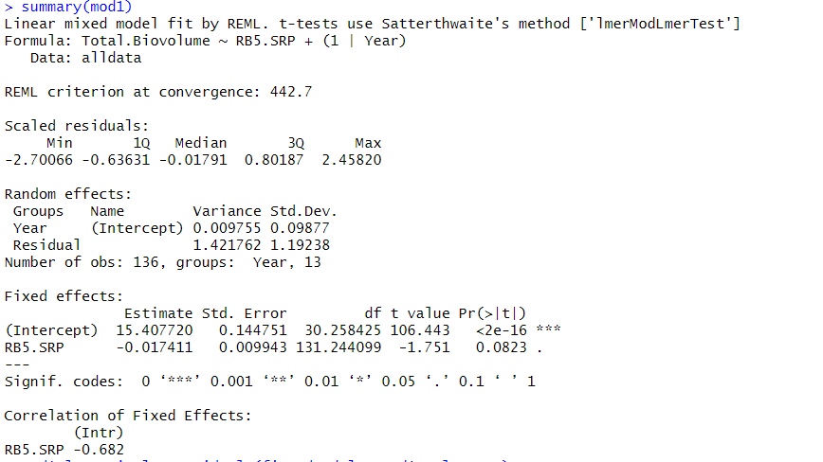

Slide 5
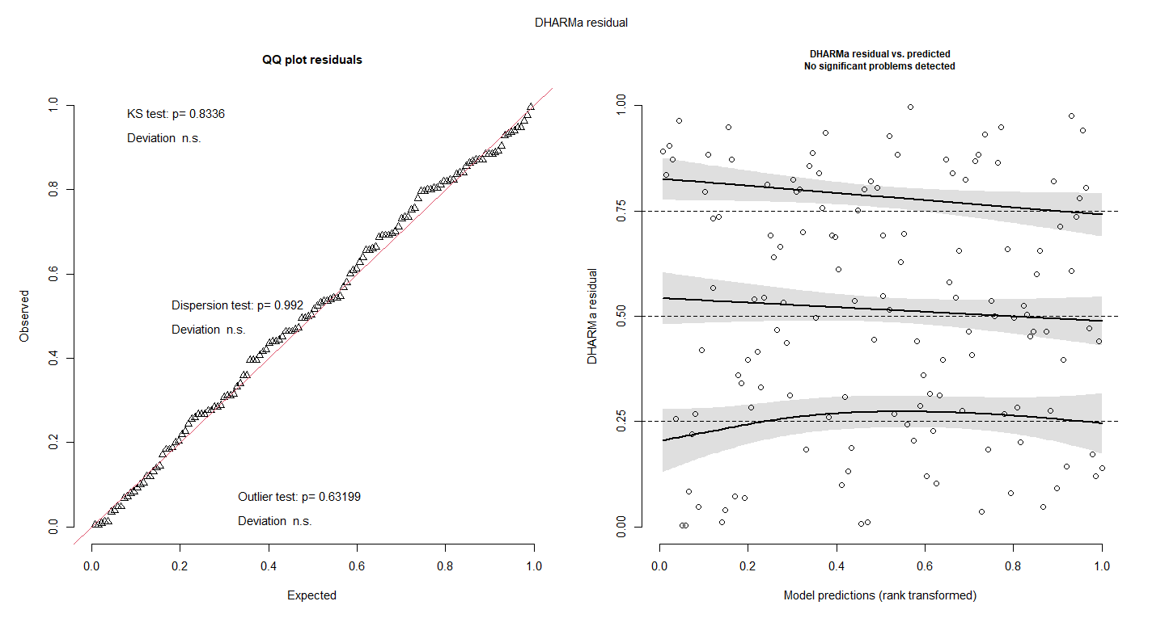

Slide 6
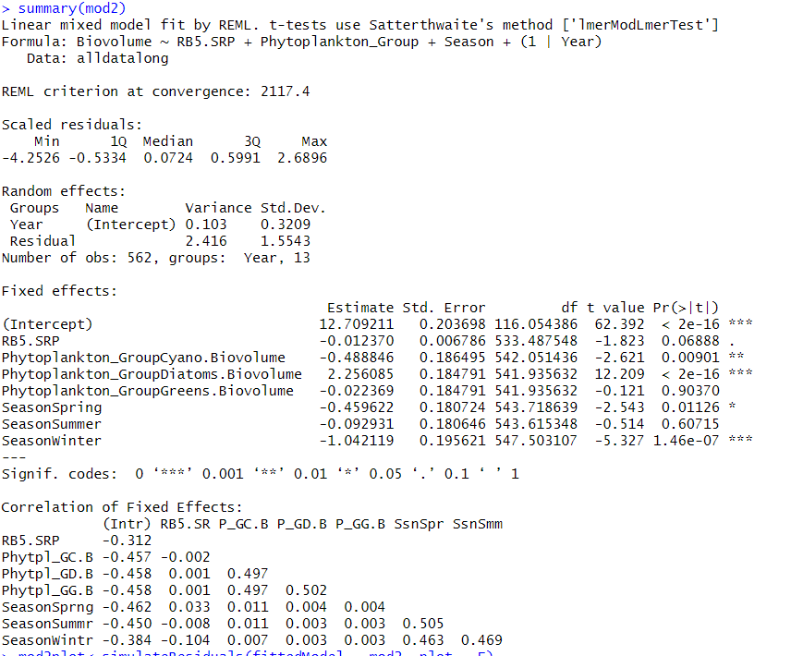
Throw Away

Slide 7
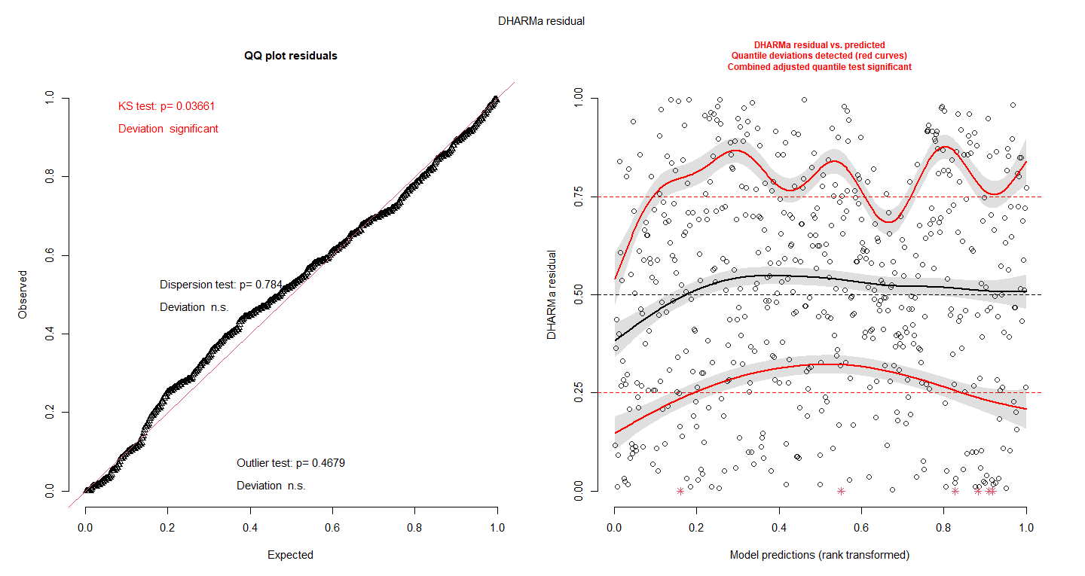

Slide 8
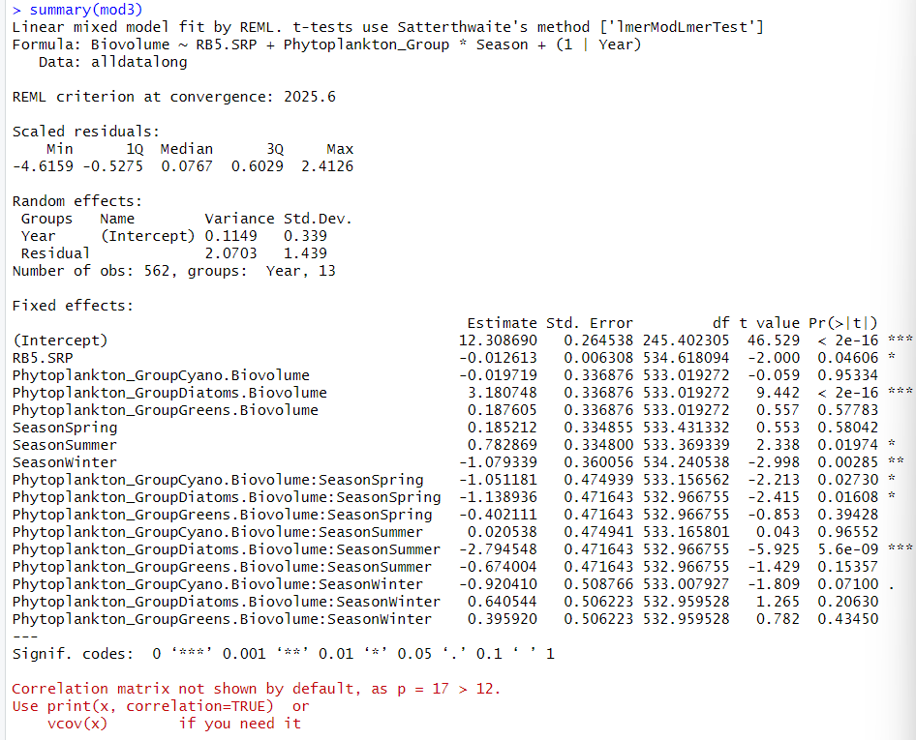

Slide 9
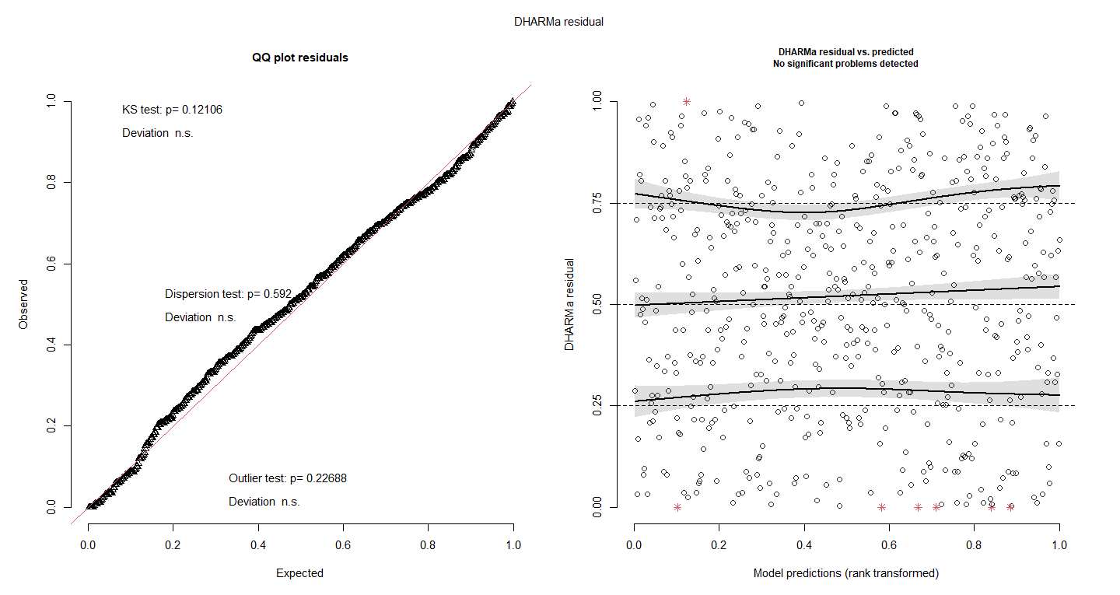

Slide 10
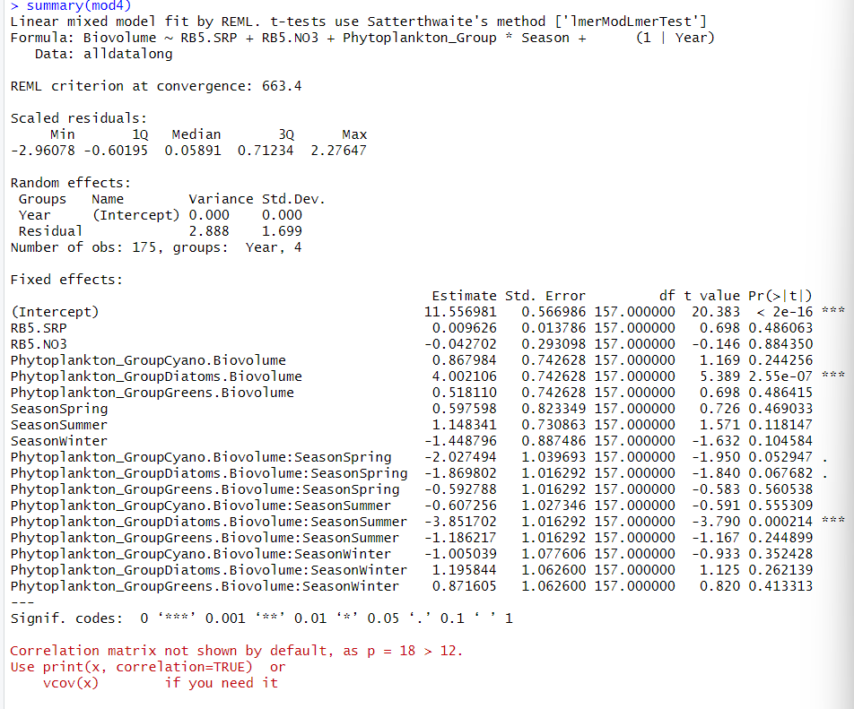

Slide 11
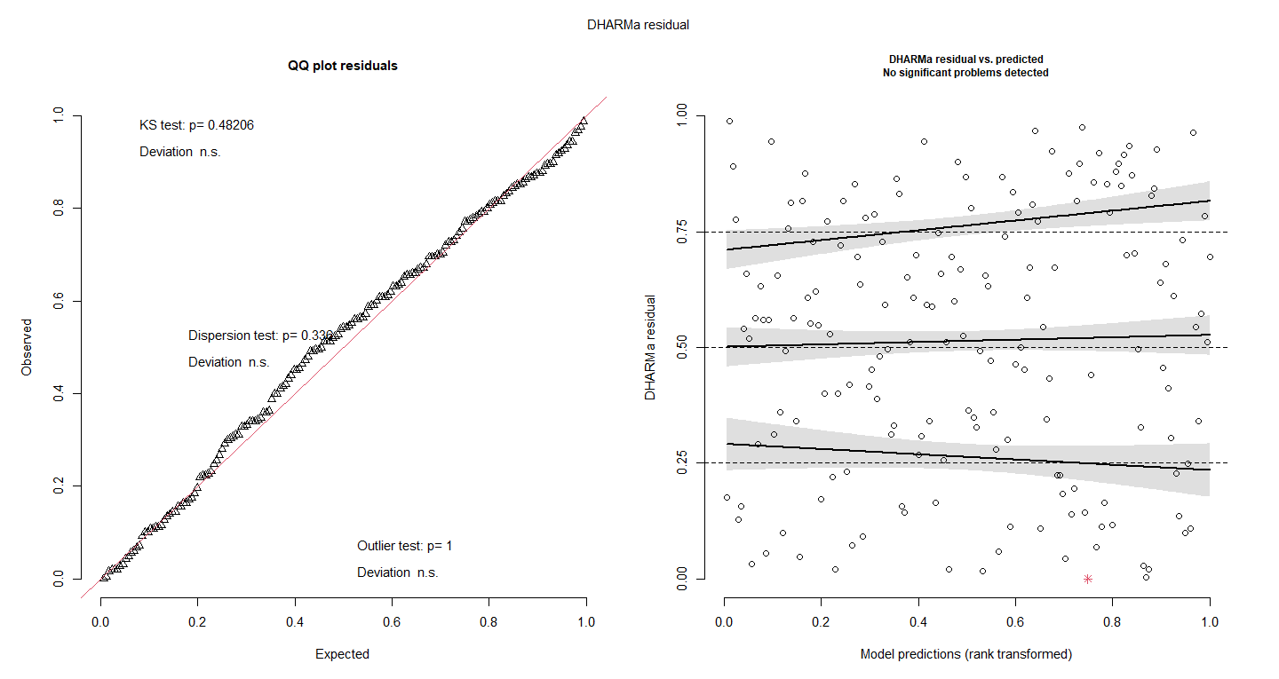

Slide 12
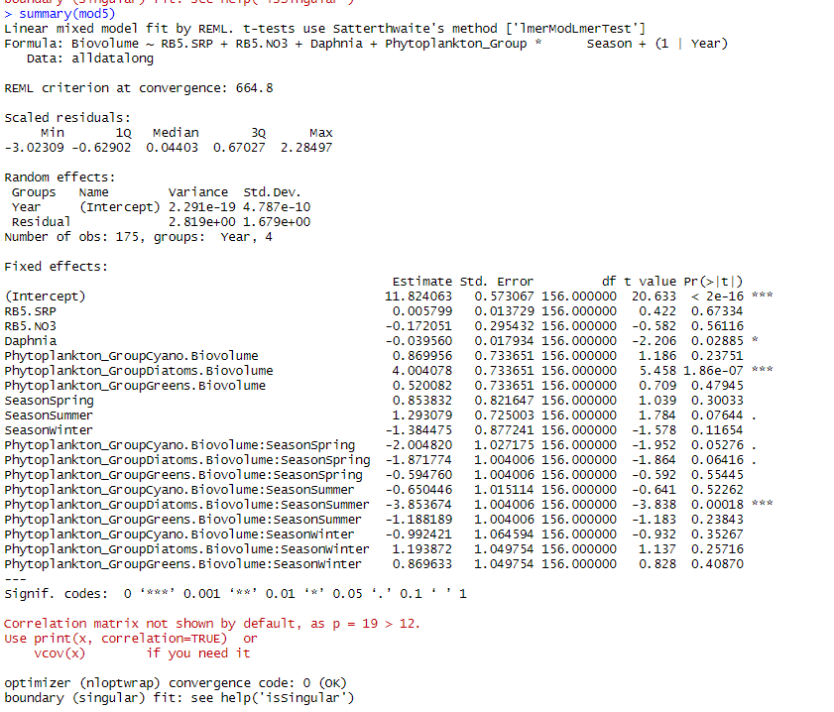

Slide 13
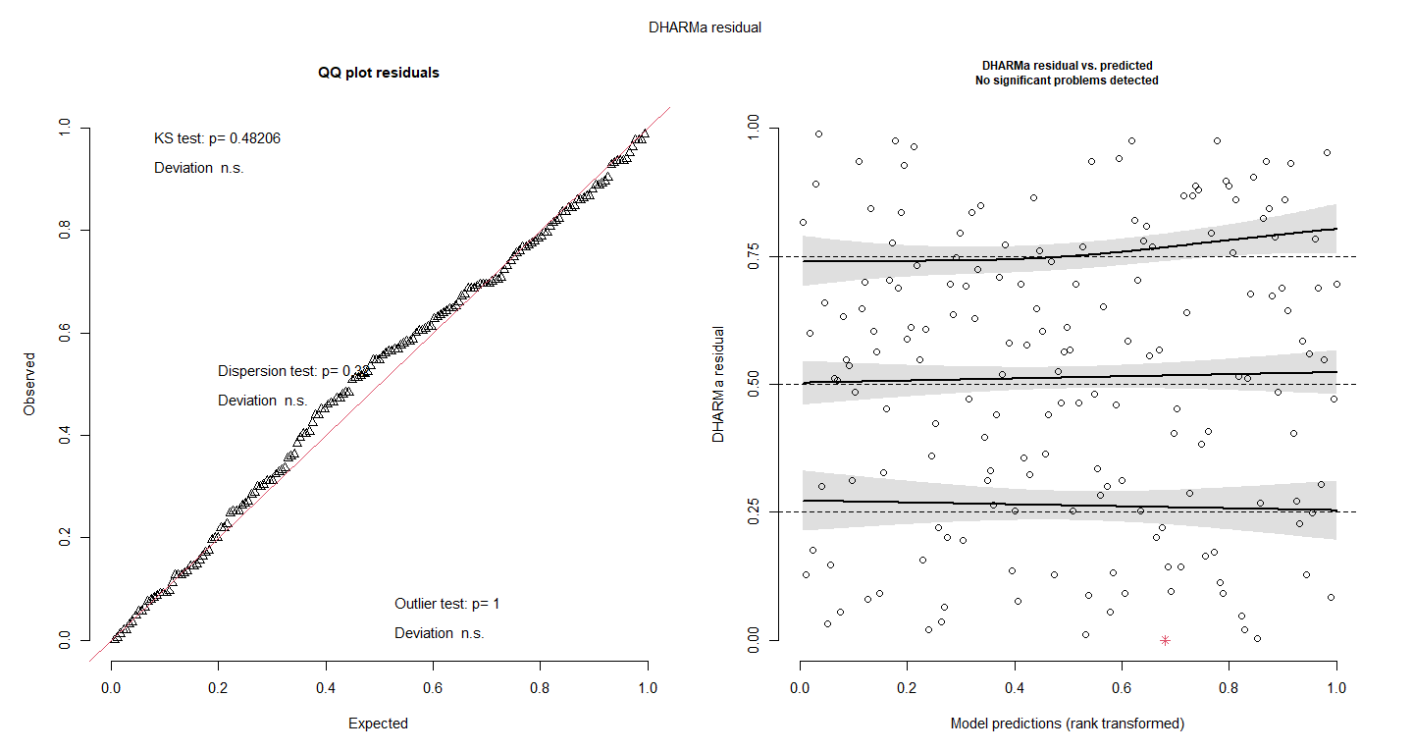

Slide 14
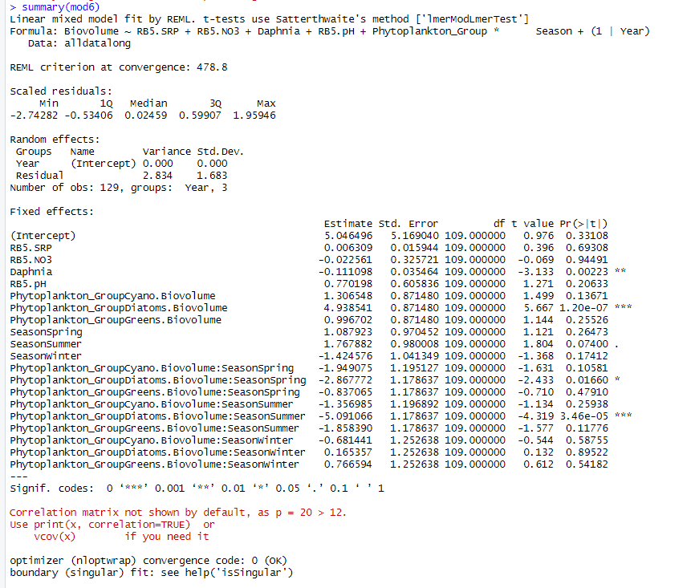
Try to scale pH or normalisation
Read about it – how to approach scaling or normalising for pH

Slide 15
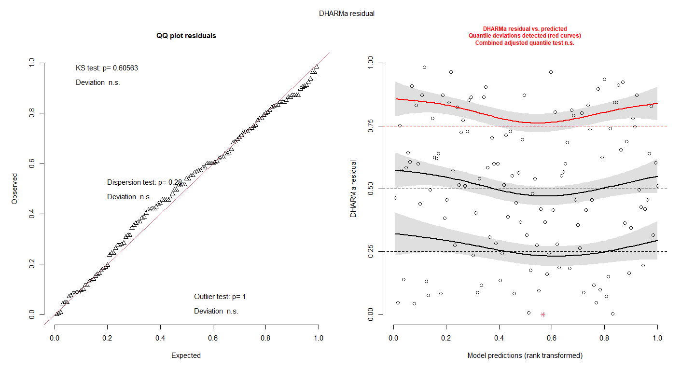

Slide 16
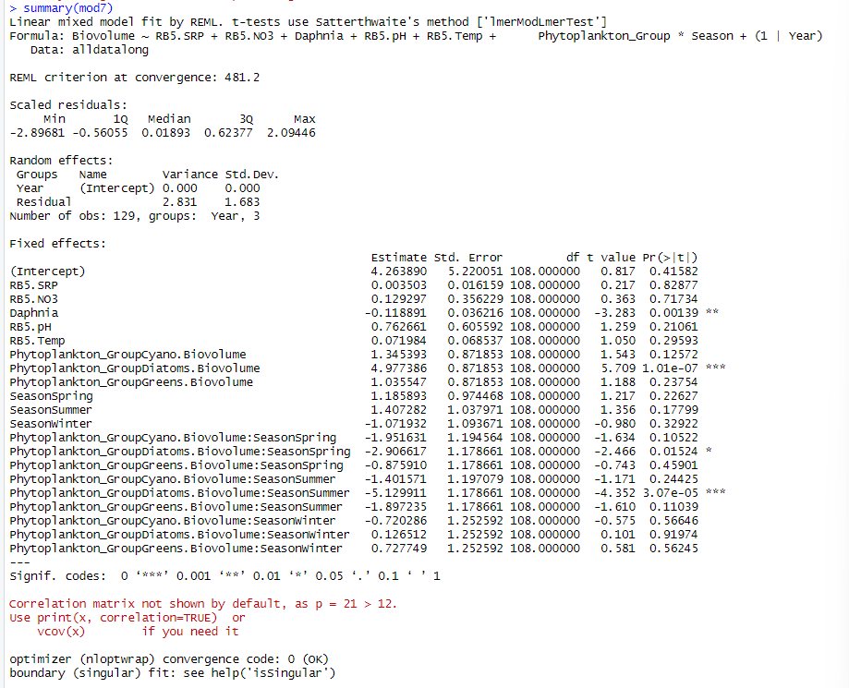

Slide 17
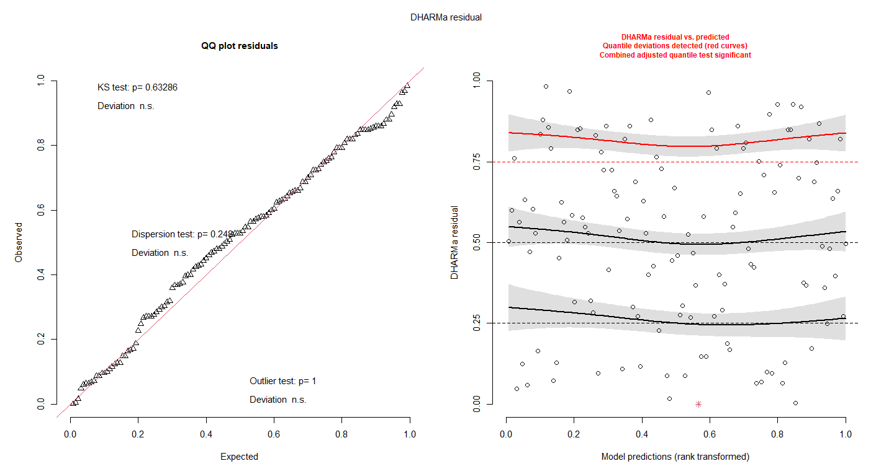

Slide 18
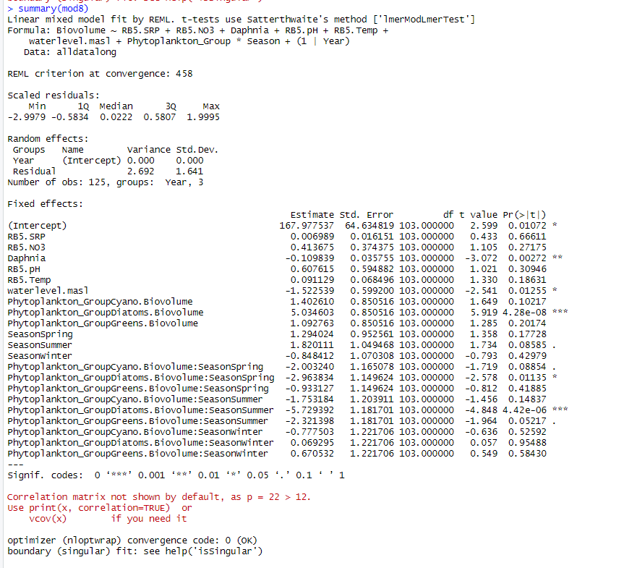

Slide 19
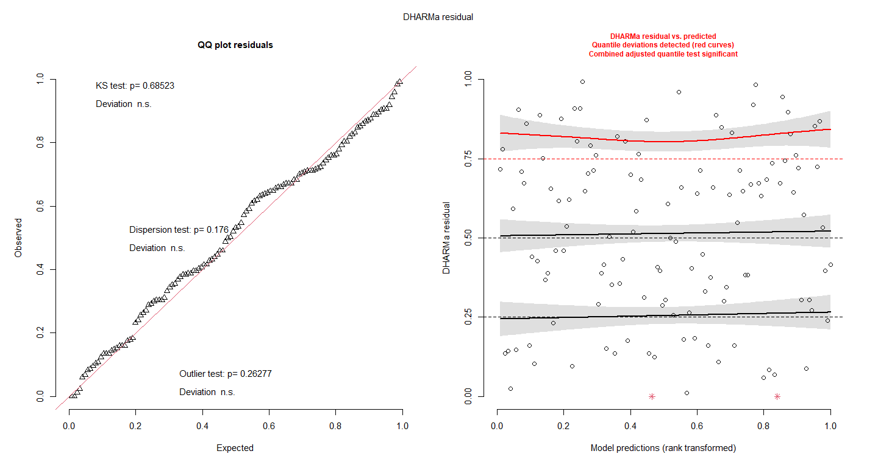

Slide 20
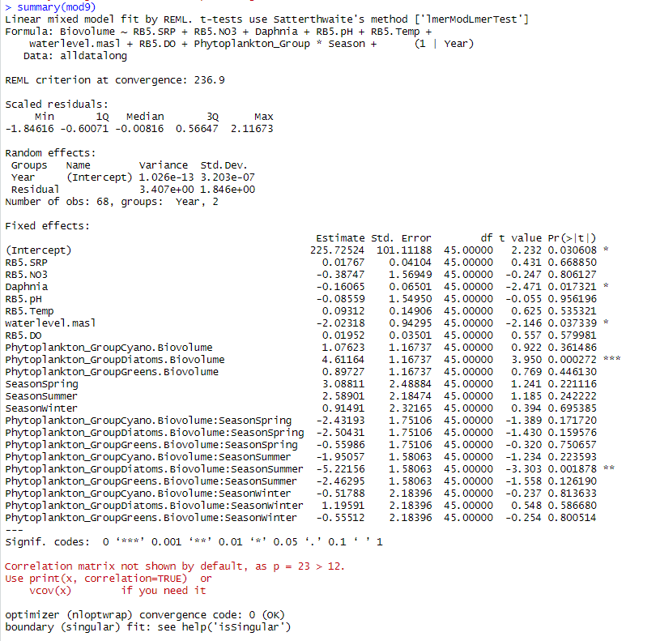

Slide 21
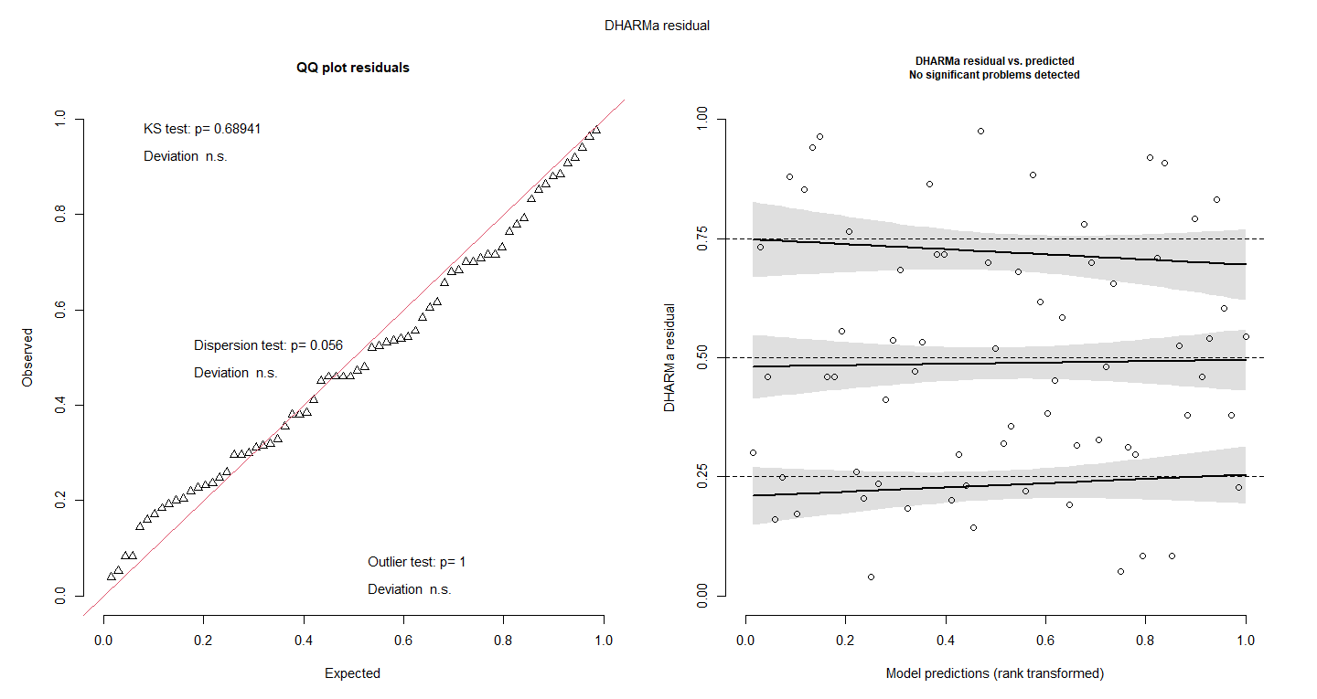

Slide 22
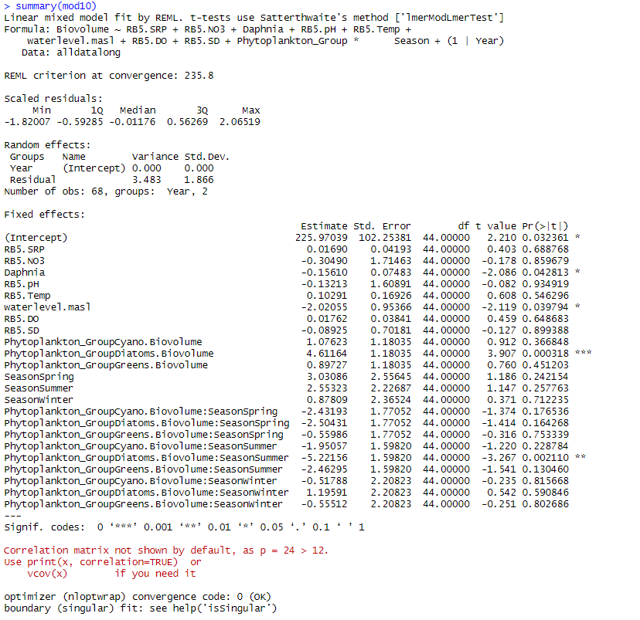
Trash??
Try to 1/srt(biovolume)
Or boxcox transformation
Just for this model
Have to be careful with presenting
Cannot use AIC, maybe use R2 instead

Slide 23
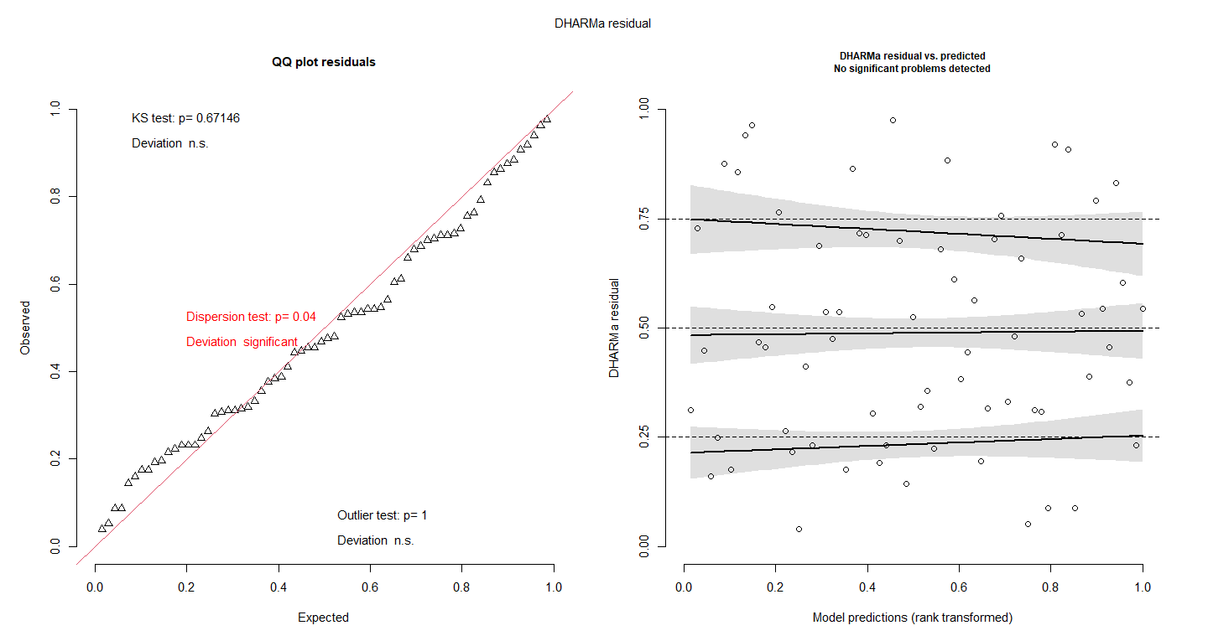

Slide 24
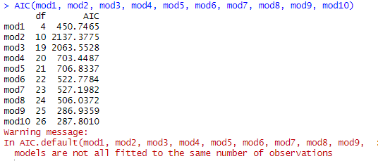
R2 doesn’t punish for overfitting
But AIC does punish for overfitting – and its still getting lower – so its getting better
Run everything without nitrate??
Table that has models with NO3 and models without NO3 and then AIC and R2
Look at multicollinearity – DO and temperature – build a justification – then test
choose which one to take out
VIF over 10 then remove one
Quality control

Slide 25
How to test the effect of seasonality on phytoplankton groups
Log transformed the phytoplankton
Ran mixed linear models or each phytoplankton group
Tested model assumptions using DHARMa

Slide 26
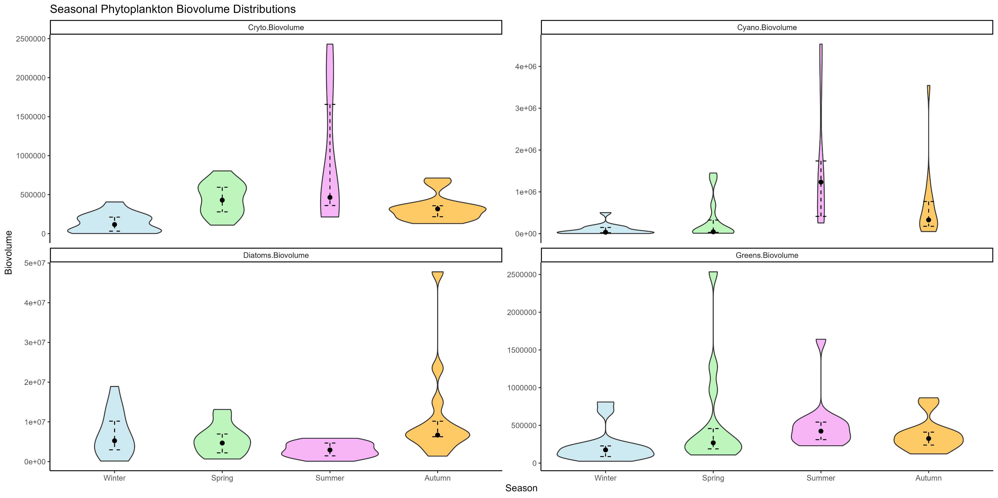
Log the yaxis
Add prints onto the graph
To show significance

Slide 27
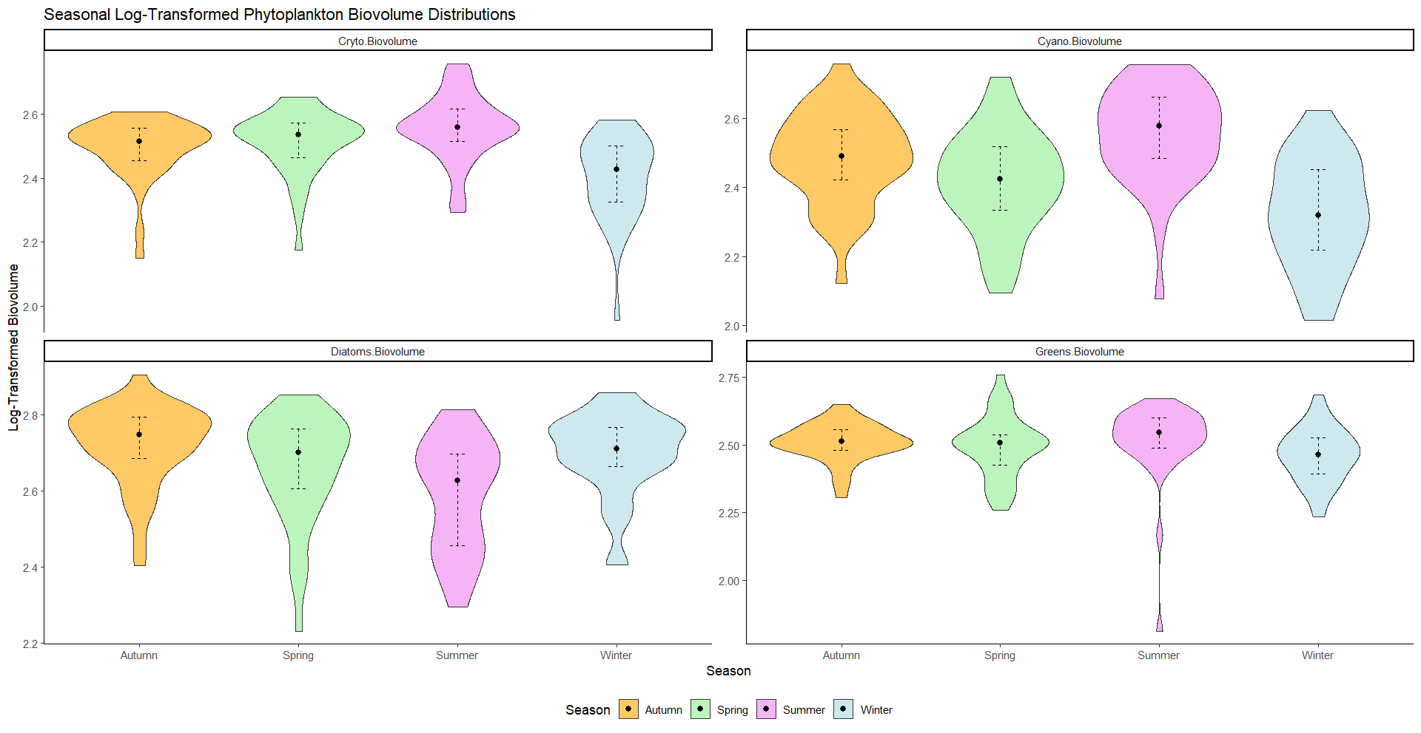

Slide 28
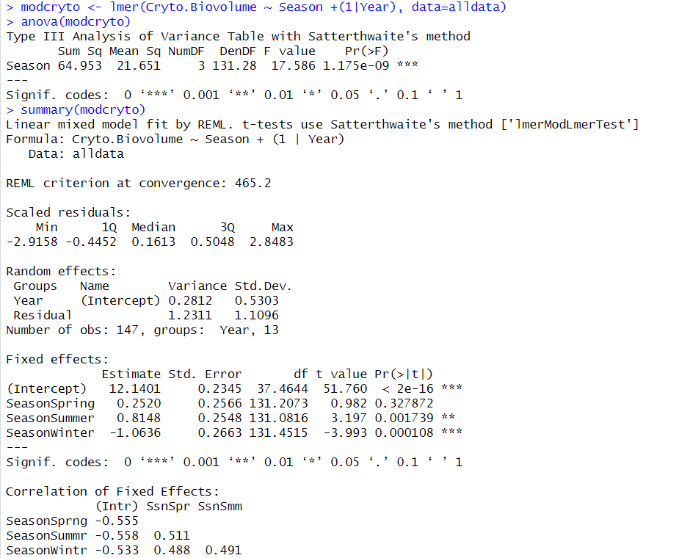
Remember to change the order to winter-spring-summer-autumn
Tell linear model to make winter the intercept
When reporting differences report using actual biovolumes (unlog)
Might want to nest the season in year

Slide 29
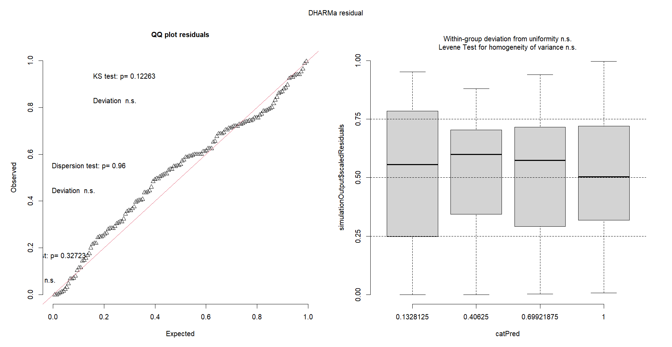

Slide 30
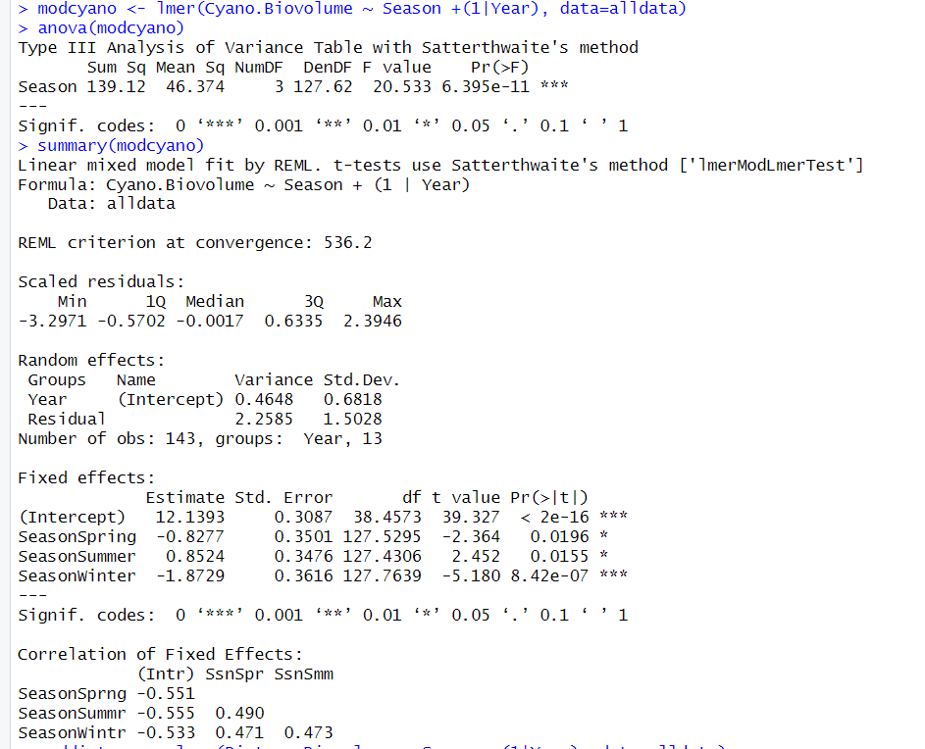

Slide 31
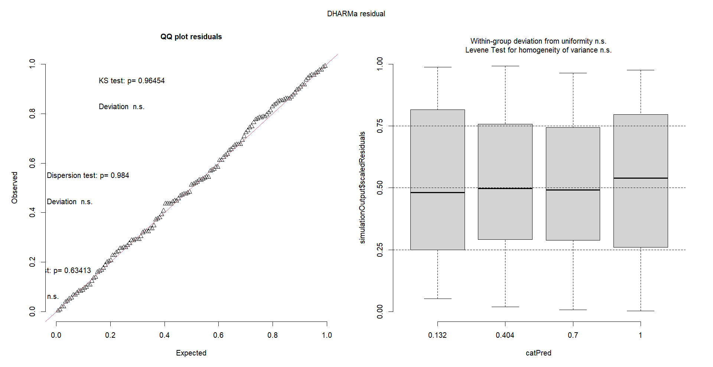

Slide 32
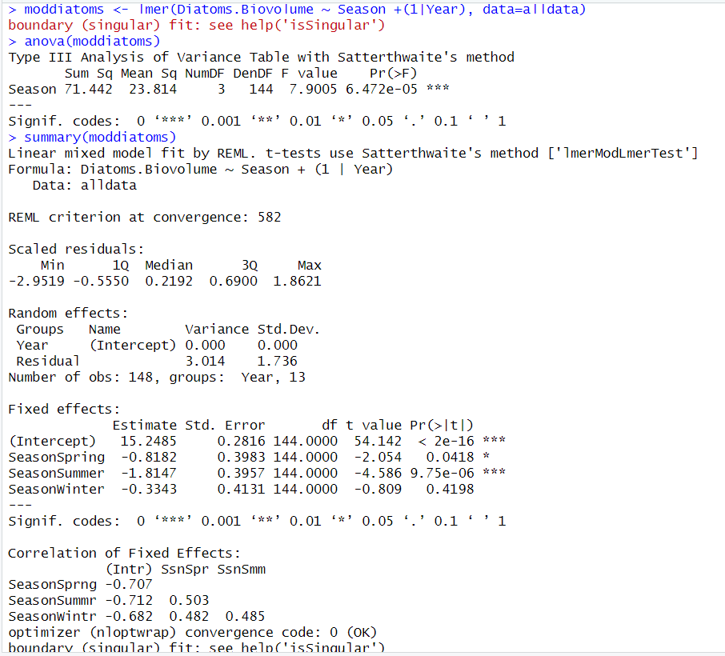

Slide 33
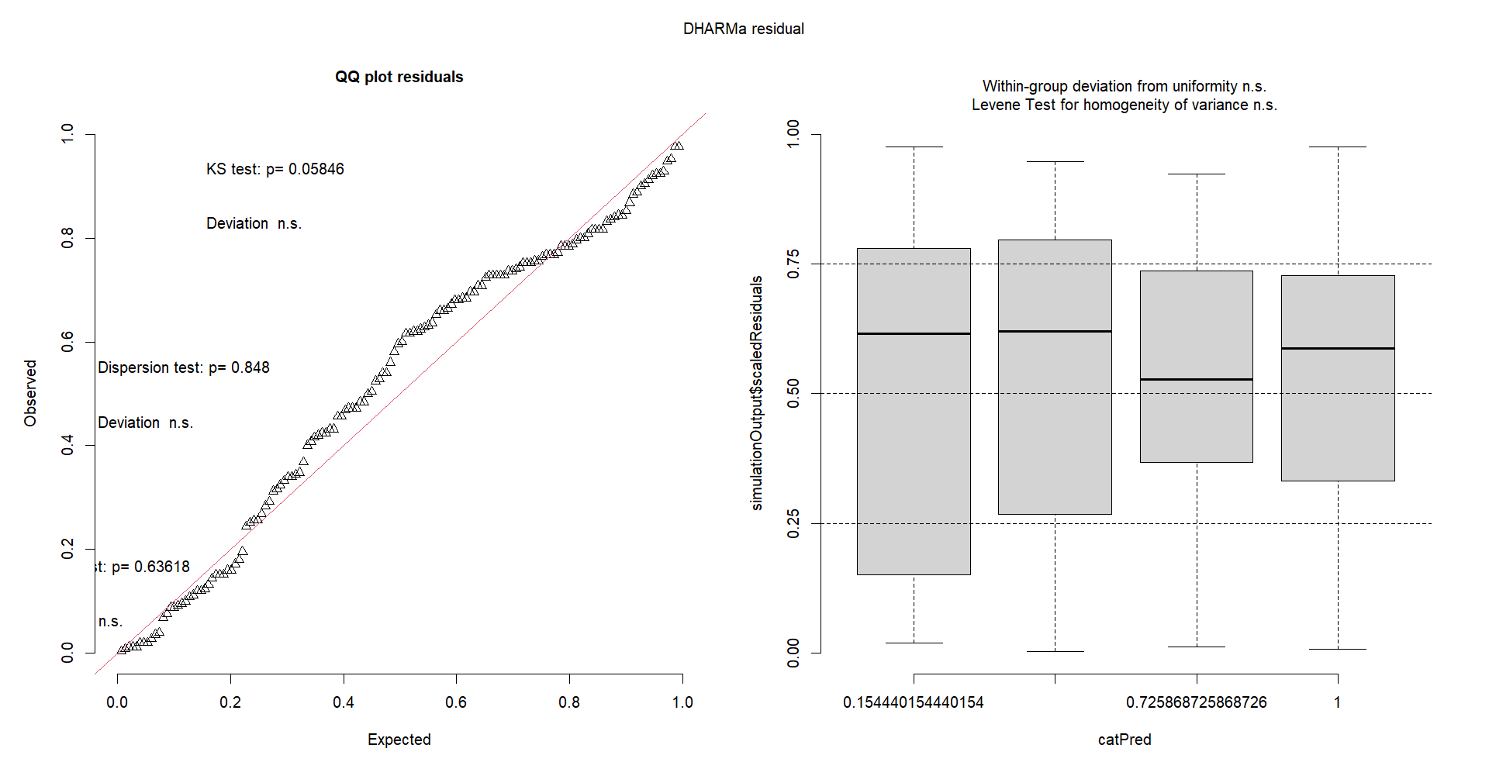

Slide 34
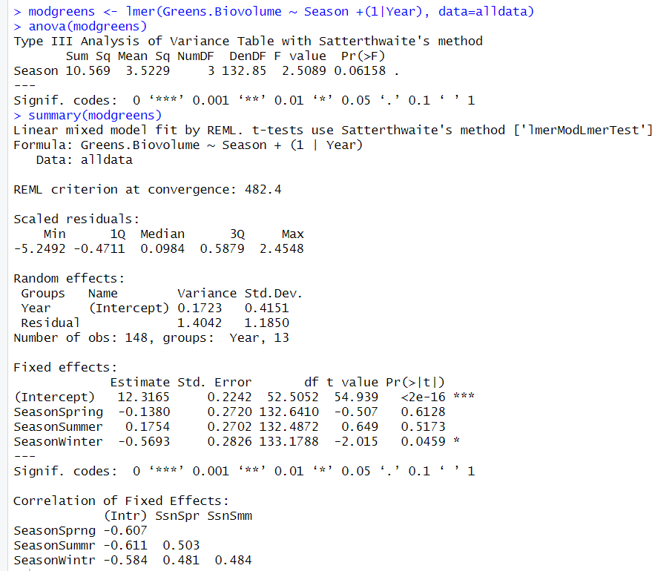

Slide 35
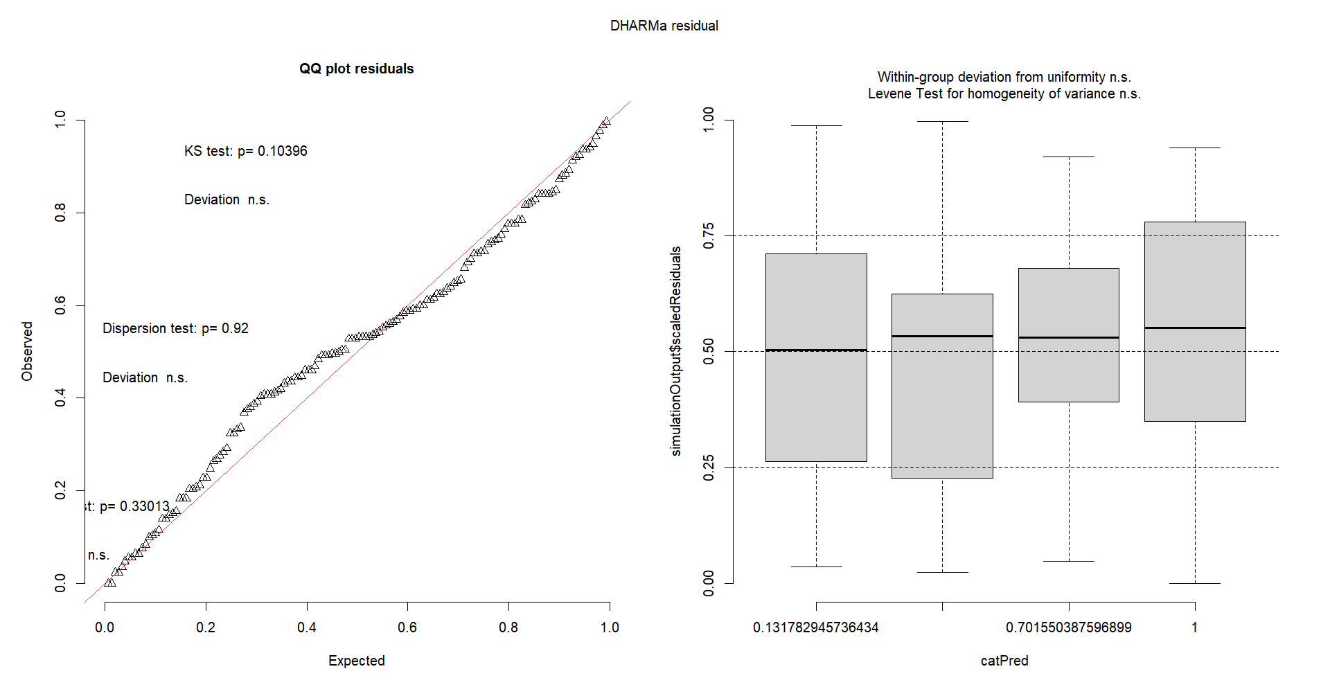

Slide 36
Seasonal Daphnia Trends
Remove the colours for seasons
Lm between non diatom groups with Daphnia
1 to 1 plot
Daphnia density + non diatom biovolume – scatter plot (1:1 line)

Slide 37
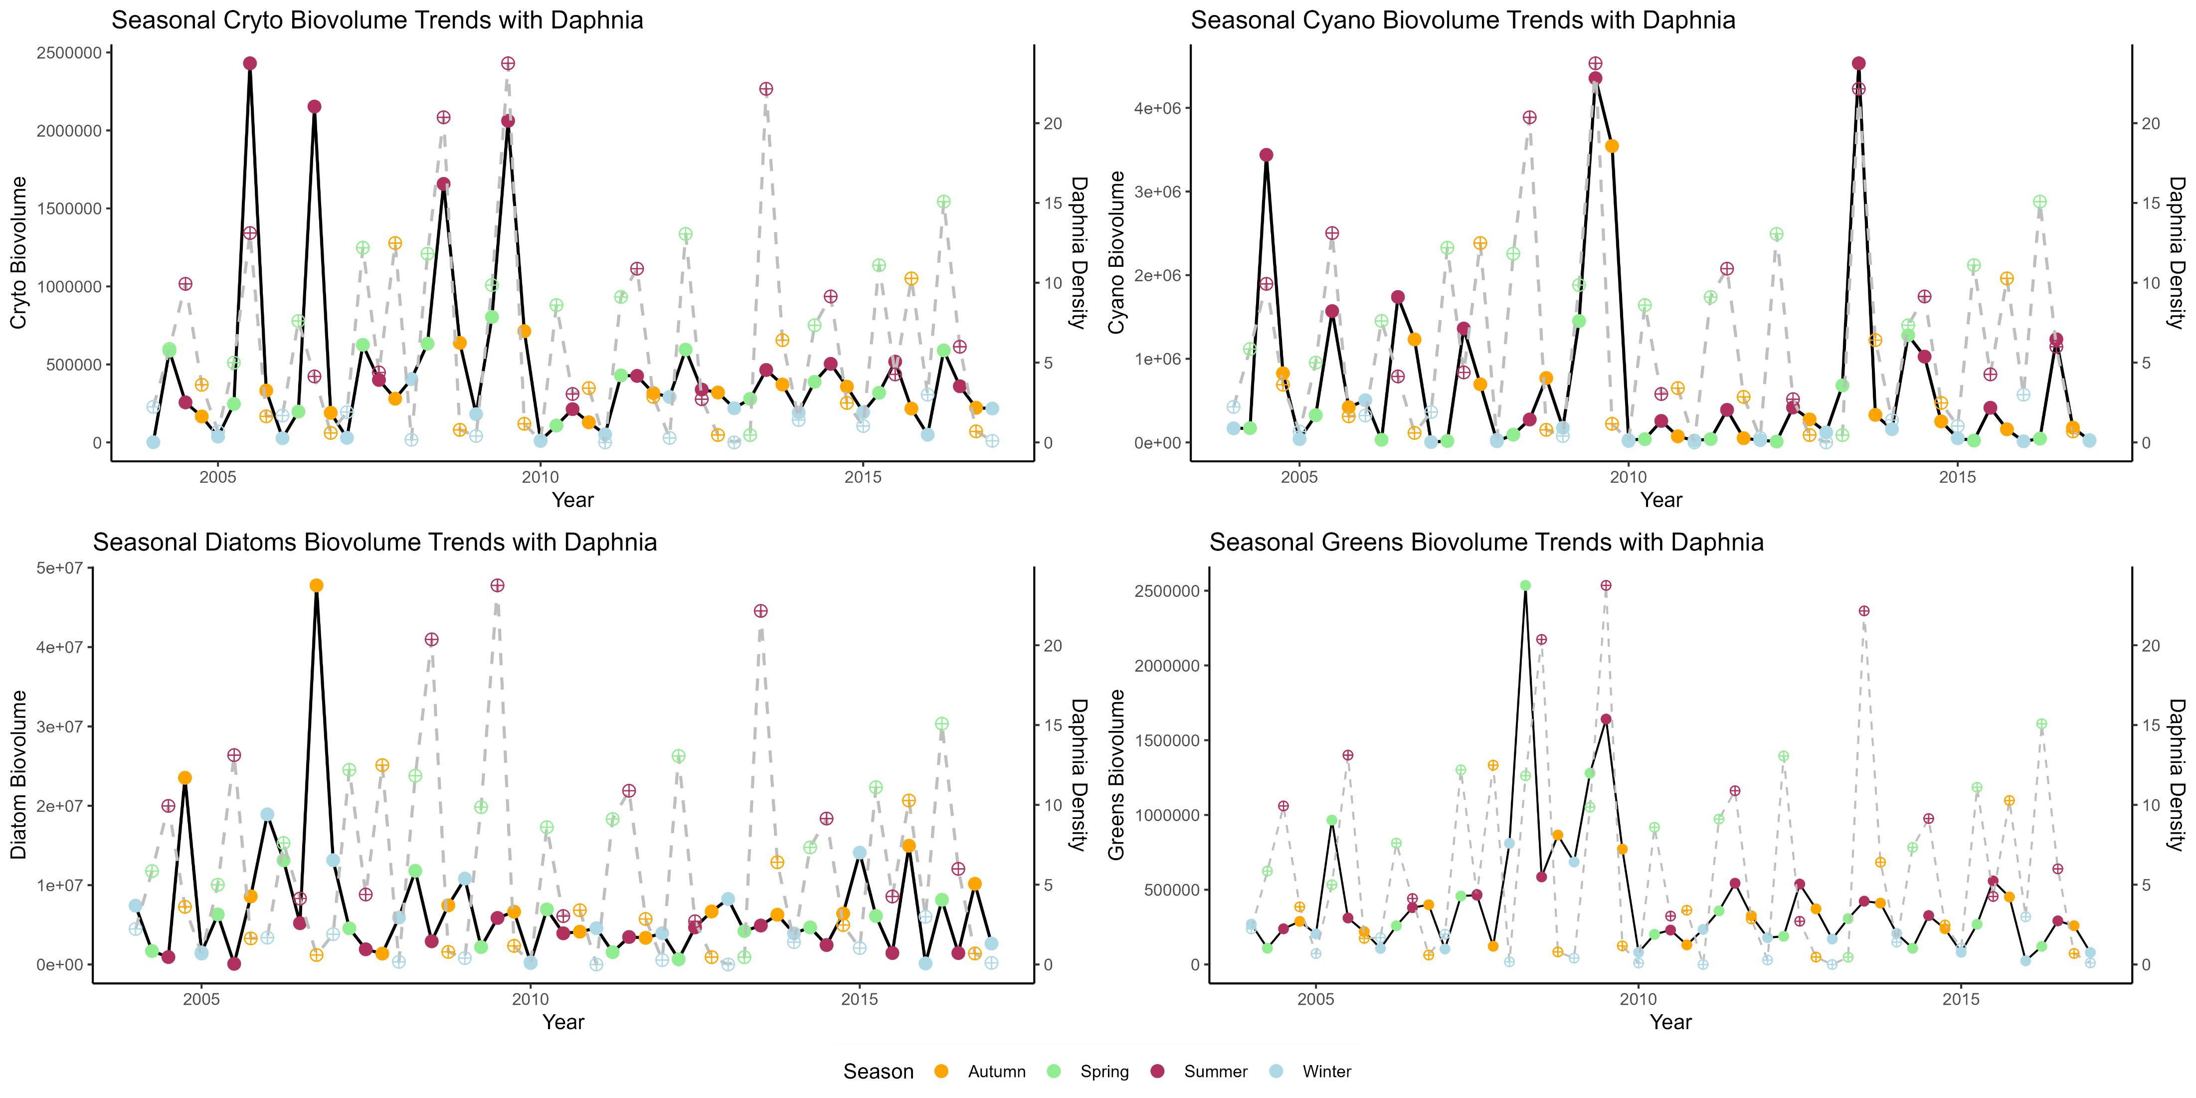

Slide 38
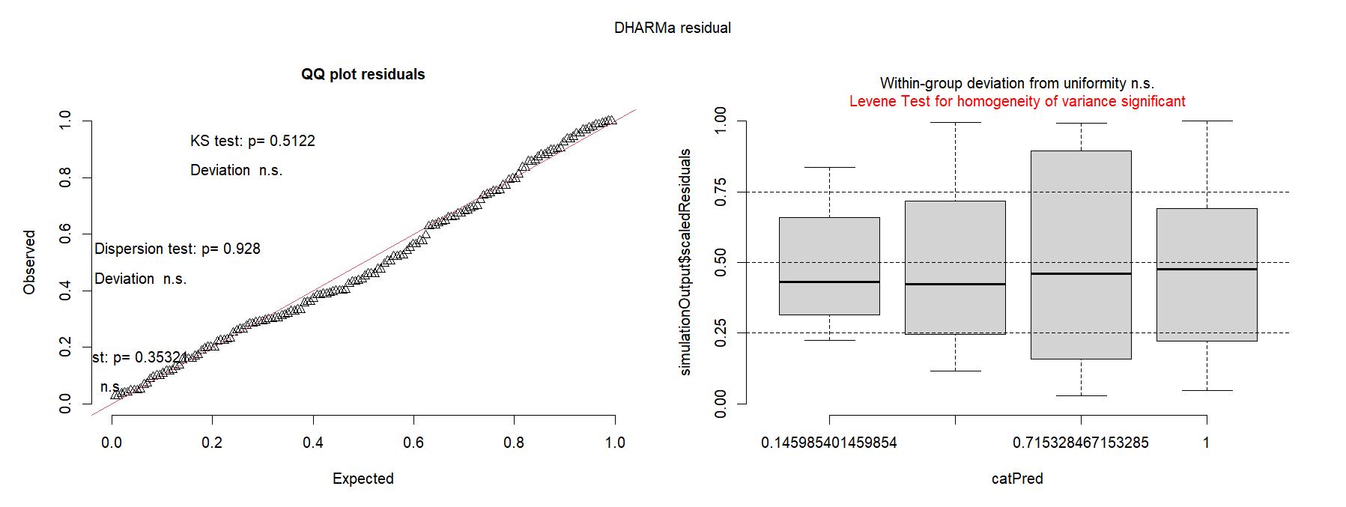
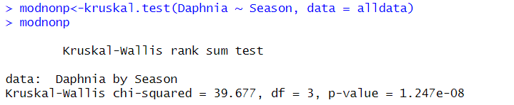
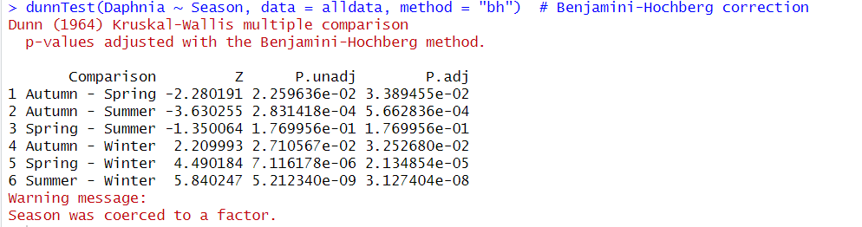
Trash

Slide 39
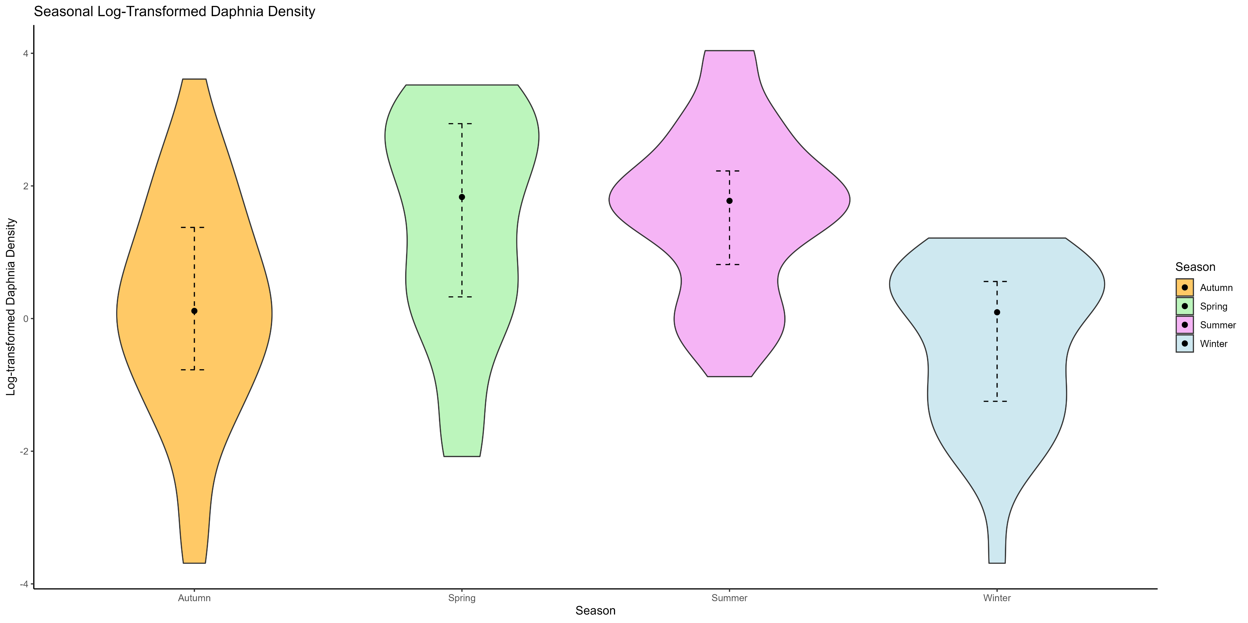
Trash

